Slide 1
A real life clustering example on complex data
Jean-Charles LAMIREL
Synalp-Team-LORIA
University of Strasbourg
WISELAB – DALIAN (Sea-sky Scholar)
Notes:
Madame et monsieur les membres du jury bonjour.
Je présente mon travaille de thèse intitulé modèles neuronaux non supervisés cartographique pour le traitement des données documentaires multimédia, et leur application à l’analyse du web.
Ce travaille est fait au sein de l’équipe cortex au loria

Slide 2
Introduction
Data mining is a machine learning domain which raises difficult challenges mainly because of high dimensional data and large datasets:
Facing with learning or mining model evaluation
Facing with distance ambiguities or inefficiency
Facing with multiple data representations
Facing with synthetizing and visualizing mining results
Facing with potentially evolving data
Does it exist a federating approach that can globally deal with such problem ?
Could the approach be exploited for visualization and management of big graphs ?
Notes:
Les méthodes de classification non supervisées proposent des solutions variées donc, l’évaluation de la qualité de classification numérique non supervisée ainsi le nombre de classes générées est une opération importante pour décrire mieux les données.
Les critères les plus utilisée pour ce propos sont les critères inertiels. Ces critères pose cependant de nombreux problème d’interprétation et de dépendance de méthode de classification utilisée.
Nous proposons donc deux ensembles de critères de qualité qui sont qui prennent en compte ces problèmes à savoir la qualité pour les données basées sur leur espace de description et la qualité pour les données avec des étiquettes multiples.

Slide 3
Presentation plan
Principle of feature maximization metric (F-max)
Exploiting F-max for complex data analysis
Novel approaches based on clustering and contrast graphs
Some results comparison with LDA
Extension of feature maximization metric for community role detection
Perspectives
Notes:
Les méthodes de classification non supervisées proposent des solutions variées donc, l’évaluation de la qualité de classification numérique non supervisée ainsi le nombre de classes générées est une opération importante pour décrire mieux les données.
Les critères les plus utilisée pour ce propos sont les critères inertiels. Ces critères pose cependant de nombreux problème d’interprétation et de dépendance de méthode de classification utilisée.
Nous proposons donc deux ensembles de critères de qualité qui sont qui prennent en compte ces problèmes à savoir la qualité pour les données basées sur leur espace de description et la qualité pour les données avec des étiquettes multiples.

Slide 4
A new metric for high dimensional data management : the F-max metric
Notes:
Le premier ensemble que nous proposons consiste en deux critères qui ne représente pas de biais.
Le rappel de classification mesure l’exhaustivité du contenu des classes par calculer la moyenne des rapports entre le nombre de membres de classes contiennent la propriété propre p dans les classes et le nombre total de membres qui la contiennent.
La précision de classification mesure l’homogénéité du contenu des classes par calculer la Moyenne des rapports entre le nombre de membres de classes contiennent la propriété propre p dans les classes et le nombre total de membres dans les mêmes classes
Ces mesures servent ainsi à une sélection de modèle optimal et à la comparaison entre les méthodes de classification

Slide 5




An alternative to usual metrics : the feature maximization metric [Lamirel 08]
Let us consider a set of clusters C resulting from a clustering method applied on a set of data D represented with a set of descriptive features F, feature maximization is a metric which favors clusters with maximum Feature F-measure which represents the harmonic mean between :
$${FR}_{c}(f)=\frac{\sum_{d∈c}{W_{d}^{f}}}{\sum_{c^{′}∈C}{\sum_{d∈c^{′}}{W_{d}^{f}}}}$$
$$≡P\left(c\right|f)$$
Feature Recall
$${FP}_{c}(f)=\frac{\sum_{d∈c}{W_{d}^{f}}}{\sum_{f^{′}∈F^{c},d∈c}{W_{d}^{f^{′}}}}$$
Feature Predominance
$$≡P\left(f\right|c)$$
A maximized cluster feature is a feature whose Feature F-measure is maximized by the cluster members (i.e. data).
Notes:
Le premier ensemble que nous proposons consiste en deux critères qui ne représente pas de biais.
Le rappel de classification mesure l’exhaustivité du contenu des classes par calculer la moyenne des rapports entre le nombre de membres de classes contiennent la propriété propre p dans les classes et le nombre total de membres qui la contiennent.
La précision de classification mesure l’homogénéité du contenu des classes par calculer la Moyenne des rapports entre le nombre de membres de classes contiennent la propriété propre p dans les classes et le nombre total de membres dans les mêmes classes
Ces mesures servent ainsi à une sélection de modèle optimal et à la comparaison entre les méthodes de classification

Slide 6
Measures based on data description space
A simplified view with binary Recall and Precision [Lamirel 04]
Cluster C₁
Cluster C₂
D₅
R ( ) = 1
R ( ) = 4/5
D₁
D₆
P ( ) = 1
P ( ) = 1
D₂
D₇
R ( ) = 1
R ( ) = 1
D₃
P ( ) = 2/3
D₈
P ( ) = 1/2
Cluster associated data
Cluster associated data
: Data properties
: Data properties
The R, P, F–measure criteria are independent of the clustering method (symbolic equivalence).

Slide 7
Feature maximization metric
Extended use
In machine learning feature maximization metric proved to have very various use, like:
Extraction of association rules* [Lamirel 06]
Optimizing learning [Attik 06]
Cluster labeling and cluster content mining [Lamirel 08]
Detecting incoherent clustering results [Lamirel 10]
Substituting to distance in clustering [Lamirel 11][Lamirel 12]
Efficient feature selection for supervised classification (dealing with class imbalance, noise, …) [Lamirel 11]
Evaluating/Correcting initial clustering results [Lamirel 16]
Substituting to distance between distribution [Lamirel 19]
SNA analysis and data synthesis and summarization [Here]
Notes:
L’idée de l’algorithme de recherche de classification optimale est celui de trouver le point d’équilibre entre le rappel et la précision et puis d’appliquer une phase d’amélioration autour du point d’équilibre pour augmenter la qualité globale de résultats en augmentant la précision pour un rappel similaire.

Slide 8
A simple example
We consider a sample of Men (M) and Women (F) for which we measure Hair_length and Shoes_size and Nose_size
Shoes _size | Hair _length | Nose _size | Class
9 | 5 | 5 | M
9 | 10 | 5 | M
9 | 20 | 6 | M
5 | 15 | 5 | F
6 | 25 | 6 | F
5 | 25 | 5 | F

Slide 9

A simple example
We compute the Feature Recall (FR) and the Feature Precision (FP) and the Feature F-measure (FF) for each class and each feature and each class
Shoes _size | Hair _length | Nose _size | Class
9 | 5 | 5 | M
9 | 10 | 5 | M
9 | 20 | 6 | M
5 | 15 | 5 | F
6 | 25 | 6 | F
5 | 25 | 5 | F
FR(S,M) = 27/43 = 0.62
FP(S,M) = 27/78 = 0.35
FF(S,M) = $\frac{2(FR\left(S,M\right)×FP\left(S,M\right))}{FR\left(S,M\right)+FP(S,M)}$
= 0.48

Slide 10
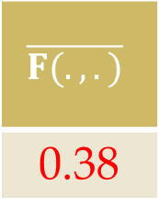
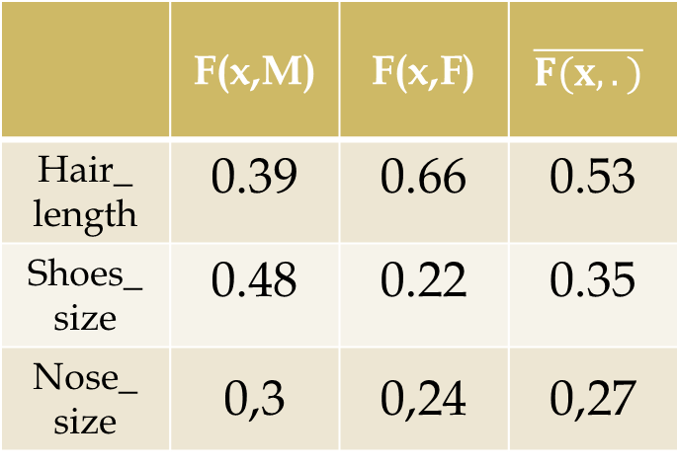
A simple example
We compute the average marginal values of Feature F-measure by feature (local) and the overall Feature F-measure for each class and each feature and each class
 | F(x,M) | F(x,F) | $$\overline{F(x,.)}$$
Hair_ length | 0.39 | 0.66 | 0.53
Shoes_ size | 0.48 | 0.22 | 0.35
Nose_ size | 0,3 | 0,24 | 0,27
The features whose
Feature F-measure is under
the global Feature F-mesure
average are removed
Nose_size is removed
The remaining (i.e. selected) features
whose F-measure is over
marginal average in one class
are considered as active in
this class
=> Shoes_size is active in Men class
=> Hair_length is active in Women class
$$\overline{F(.,.)}$$
0.38

Slide 11
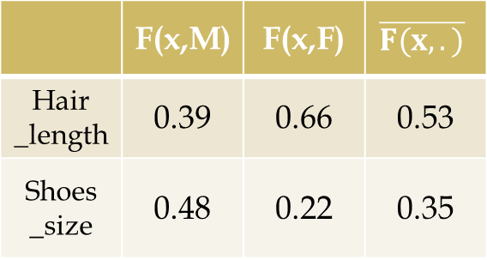
A simple example
The contrast factor highlights the degree of activity/passivity of selected features relatively to their marginal Feature F-measure average in the different classes
 | F(x,M) | F(x,F) | $$\overline{F(x,.)}$$
Hair _length | 0.39 | 0.66 | 0.53
Shoes _size | 0.48 | 0.22 | 0.35
 | C(x,M) | C(x,F)
Hair _length | 0.39/0.53 | 0.66/0.53
Shoes _size | 0.48/0.35 | 0.22/0.35
The constrast can be seen as a function
that will tend to:
Overlength the Hairs of Women
Oversize the Shoes of Men
Underlength the Hairs of Men
Undersize the Shoes of Women
 | C(x,M) | C(x,F)
Hair _length | 0.74 | 1.25
Shoes _size | 1.37 | 0.63

Slide 12
A simple example
The contrast is applied on the data in order to modify the feature weights depending on the data class
Shoes _size | Hair _length | Class
9 | 5 | M
9 | 10 | M
9 | 20 | M
5 | 15 | F
6 | 25 | F
5 | 25 | F
Shoes _size | Hair _length | Class
12,33 | 3.7 | M
12,33 | 7.4 | M
12,33 | 14.8 | M
3.15 | 18.75 | F
3,78 | 31.25 | F
3.15 | 31.25 | F
Original data
Contrasted data
Data contrast can change the organization of the data in the description space in a non linear way

Slide 13
A simple example
The magnification factor (k) can enhance the contrast to facilitate classification in complex cases
Shoes _size | Hair _length | Class
12,33 | 3.7 | M
12,33 | 7.4 | M
12,33 | 14.8 | M
3.15 | 18.75 | F
3,78 | 31.25 | F
3.15 | 31.25 | F
Shoes _size | Hair _length | Class
28.30 | 1.59 | M
28.30 | 3.19 | M
28.30 | 6.37 | M
0.99 | 36.47 | F
1.20 | 60.79 | F
0.99 | 60.79 | F
Contrasted data (k = 1)
Contrasted data (k = 4)
Magnification is a non linear transformation (enhance non-linearity)

Slide 14
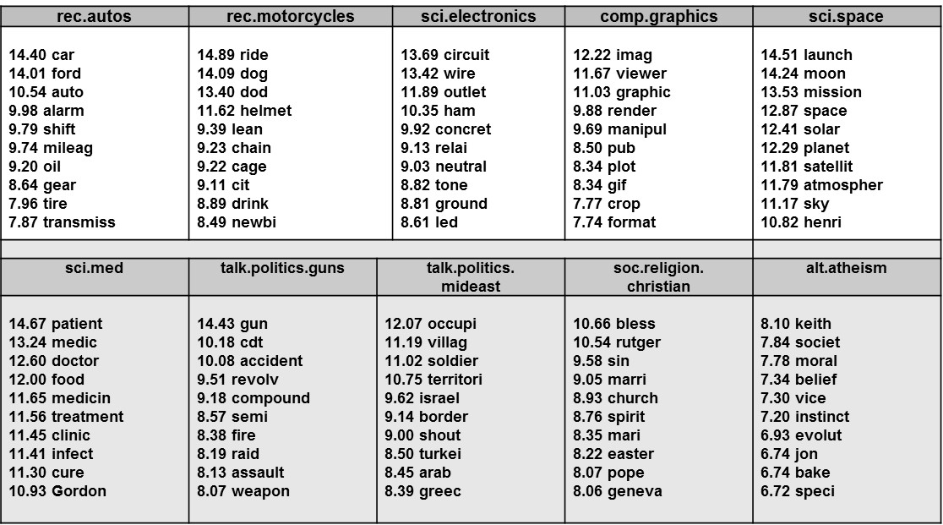
F-max feature selection and contrasting (FMC) Explanation capabilities – ex: 20 Newgroups collection
Selected features with highest contrast can be used to provide explanation on class content

Slide 15
Classification with FMC Deft challenge [JADT 2014]
Dataset of extracts of talk of CHIRAC et MITTERAND presidents:
73255 sentences of Chirac,
12320 sentences of Mitterrand.
Best results till now on that dataset : 88% accuracy (almost 16850 bilateral errors) by LIA.
Result with feature maximization : 99,999% accuracy (12 unilateral errors)
Strong feature selection (~50000 → ~5000)
Extra-light NLP preprocessing,
No lemmatization is needed,
Stop words are kept and proof to be useful for analysis.
CHIRAC
1.930810 partenariat
1.858265 dynamisme
1.811123 exigence
1.775048 compatriotes
1.769069 vision
1.768280 honneur
1.763166 asie
1.762665 efficacité
1.745192 saluer
1.743871 soutien
1.737269 renforcer
1.715155 concitoyens
1.709736 réforme
1.703412 devons
1.695359 engagement
1.689079 estime
1.671255 titre
1.669899 pleinement
1.662398 cœur
1.661476 ambition
1.654876 santé
1.640298 stabilité
1.632421 amitié
1.628630 accueil
1.622473 publics
1.616558 diversité
1.614945 service
1.612488 valeurs
1.610123 détermination
1.601097 réformes
1.592938 état
……..
MITTERAND
1.881835 douze
1.852007 est-ce
1.800091 eh
1.786760 quoi
1.777568 -
1.758319 gens
1.747909 assez
1.741650 capables
1.716491 penser
1.700678 bref
1.688314 puisque
1.672872 on
1.662164 étais
1.620722 parle
1.618184 fallait
1.604095 simplement
1.589586 entendu
1.580018 suite
1.572140 peut-être
1.571393 espère
1.560364 parlé
1.550856 dis
1.549594 cela
1.538523 existe
1.535598 façon
1.529225 pourrait
1.525645 là
1.525508 chose
1.523575 époque
1.522290 production
1.519365 trouve
……..

Slide 16
Classification with FMC Dickens-Collins contreversy (stylometry)
DICKENS 1,227361 | coming
1,04304 | heart
1,197376 | going
1,531862 | boy
1,073734 | hands
1,379369 | cried
1,10153 | men
1,491942 | gentleman
1,261003 | street
1,316684 | dear
1,022143 | love
1,175788 | like
1,240113 | young
1,04989 | light
1,151491 | seemed
1,194106 | dark
1,16963 | happy
1,130386 | know
1,584914 | indeed
1,507332 | fire
1,50468 | often
1,513448 | great
1,455893 | pretty
COLLINS 1,294836 | speaking
1,534484 | answered
1,546532 | waiting
1,250605 | heard
1,575393 | servant
1,232137 | interest
1,064008 | woman
1,288278 | led
1,332932 | left
1,299098 | feel
1,123745 | remember
1,069823 | met
1,246964 | open
1,321961 | will
1,257266 | look
1,064291 | means
1,419852 | husband
1,390256 | doctor
1,538165 | present
1,193449 | suddenly
1,348551 | herself
1,376969 | truth
1,174412 | letter
DICKENS
CHILDNESS (IDF only)
COLLINS
CHILDNESS (IDF only)
The method provide exhaustive and precise results and allows fine-grained analysis modulation.

Slide 17
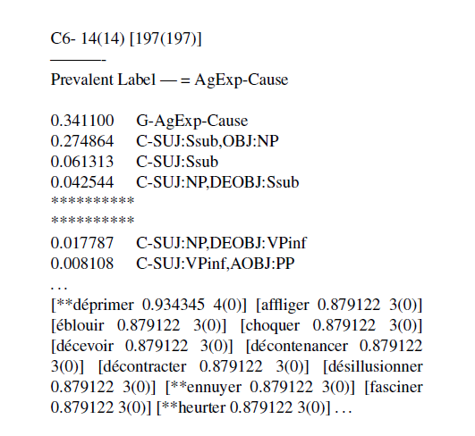
Feature maximization Exploitation in clustering [Lamirel 12]
IGNGF clustering is a parameter-free incremental neural clustering method exploiting feature maximization in substitution to standard distances (Euclidean, cosine, …)
Combines clustering and feature selection/explanation capabilities (pseudo-symbolic behavior)
Shown to outperform both state-of-the art symbolic (FCA) and numeric (Spectral Clustering) methods in complex problems: clustering of French verbs using syntactic-semantic features [Falk 12]
Can be used to highlight latent classes in classification problems: classification of institutional websites using communication signatures [Lamirel 13]
Discriminant
and shared characteristics
F-measure > F-average
Marginal characteristics
F-measure < F-average
cv
cv
Verbs ranked by representativness / class
F-max cluster labeling can be exploited with any clustering method.

Slide 18
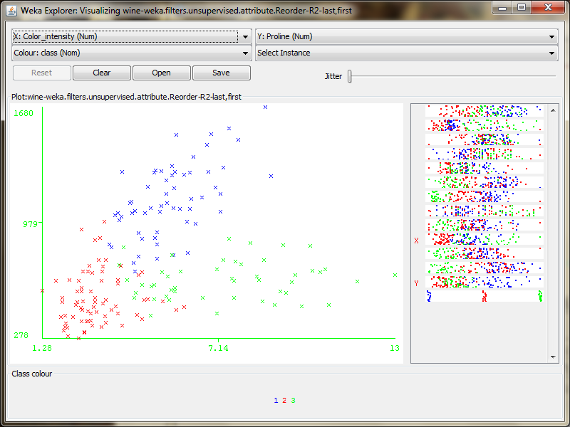
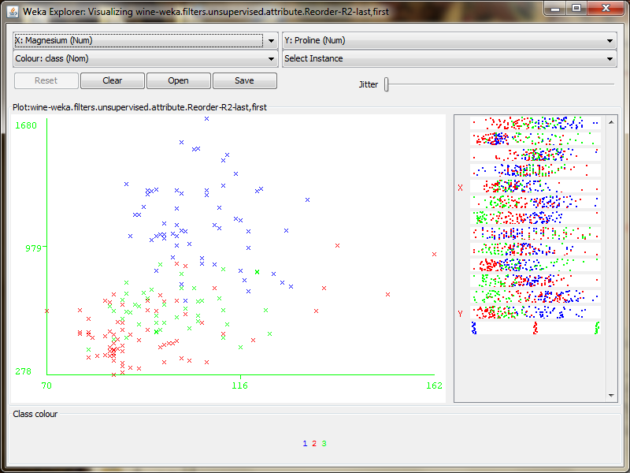
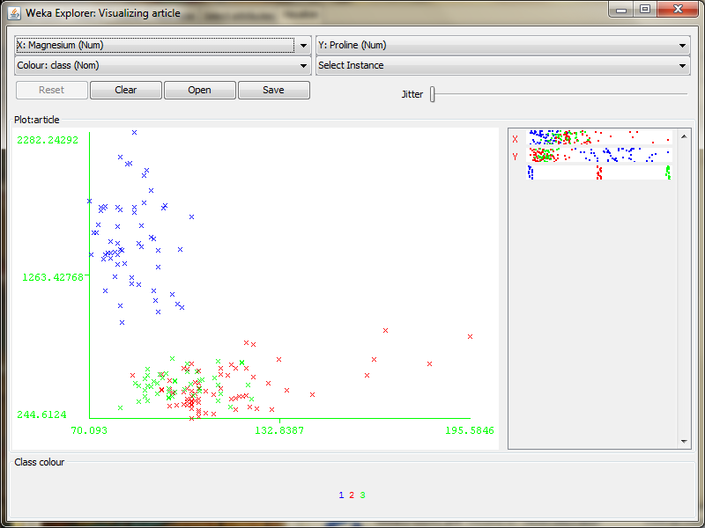
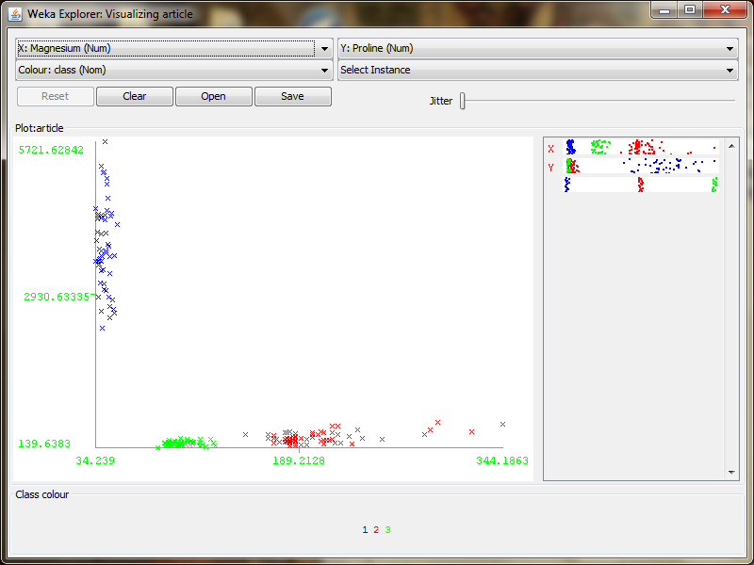
A simple numerical case Wine dataset with J48 or FMC
J48
J48 and FMC select both 2 features among 13 but
discrimination become better with FMC when magnification factor is increased
FMC
k = 1
k = 2
k = 4

Slide 19
Contrast graphs based on F-max metric
Notes:
Le premier ensemble que nous proposons consiste en deux critères qui ne représente pas de biais.
Le rappel de classification mesure l’exhaustivité du contenu des classes par calculer la moyenne des rapports entre le nombre de membres de classes contiennent la propriété propre p dans les classes et le nombre total de membres qui la contiennent.
La précision de classification mesure l’homogénéité du contenu des classes par calculer la Moyenne des rapports entre le nombre de membres de classes contiennent la propriété propre p dans les classes et le nombre total de membres dans les mêmes classes
Ces mesures servent ainsi à une sélection de modèle optimal et à la comparaison entre les méthodes de classification

Slide 20
Contrast graphs
Principle
Contrast graphs are bipartite graphs based on the relations between a set of features S and a set of labels L [Lamirel 2013].
Theoretically, the set of labels L could represent any kind of information to which features can be related with and the set of features S is a subset of a global feature set F (i.e. he original feature space on which rely the data of a dataset) that has been obtained through a feature selection process, like feature maximization.
In the case of the use of feature maximization, the weight c(u,v) of an edge (u,v), u∈S, v∈L represents the contrast of feature u for a label v.

Slide 21
Contrast graphs
Principle
Such kind of graphs have many interesting properties :
They reduce the cognitive overlead produced with classical graphs representation because of the associated feature selection process
They can be used to indirectly highlight relationships between labels, whenever features have contrasted interaction with several labels.
Third, the combination of this approach with weighted force-directed model for graph representation permits altogether to highlight central or most influent labels of the L set and to easily identify the labels that are the most densely connected through associated features.

Slide 22
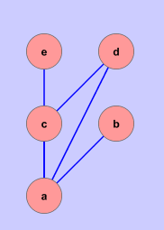
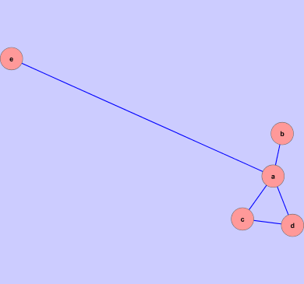
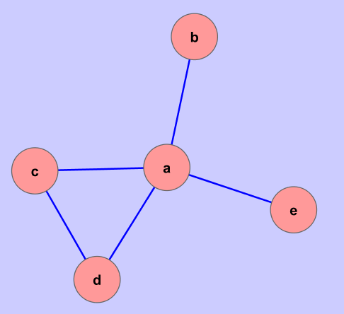
Contrast graphs
Principle
Contrast issued from feature maximization metric is used for materializing force.
Node S | Node T | Edge Weight
a | b | 1
a | c | 1/4
a | d | 1/4
a | e | 1/10
c | d | 1/4
Force directed graph
Force directed weighted graph

Slide 23
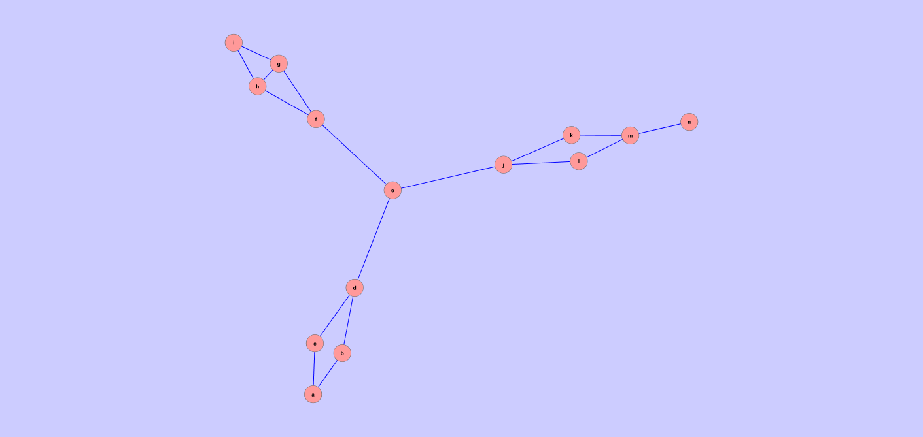
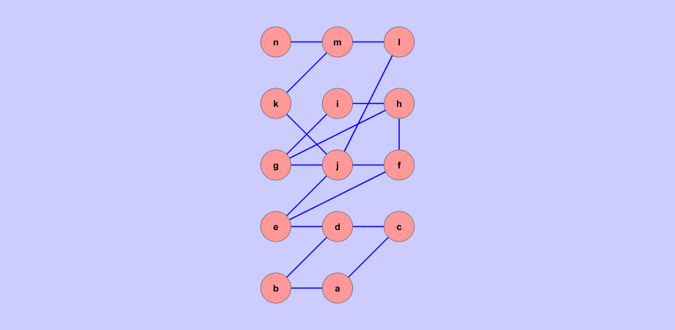
Contrast graphs
Principle
Visual analysis

Slide 24
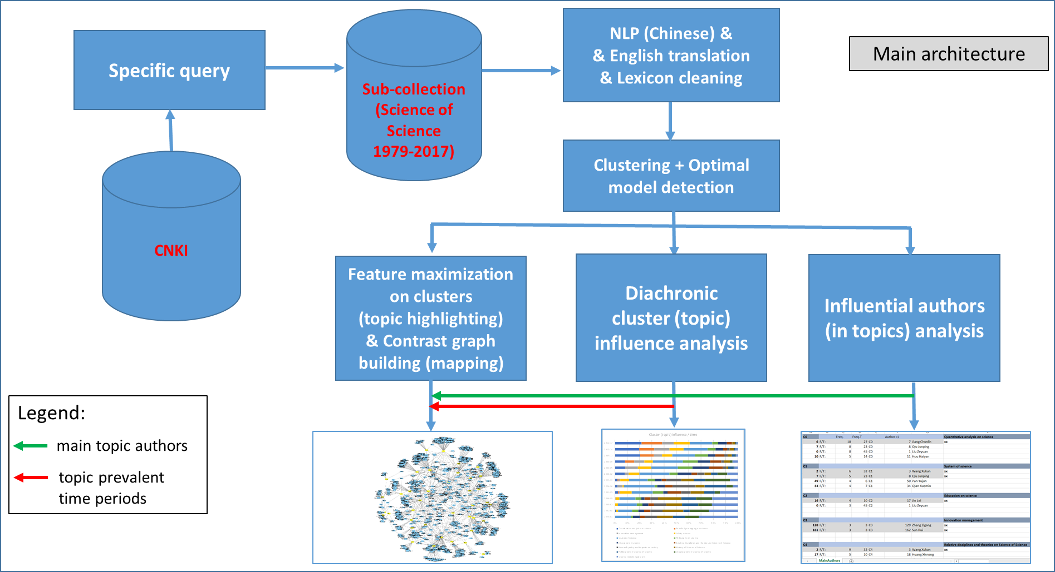
On going work on F-Max metric
Map of Science of Science history in China

Slide 25
On going work on F-Max metric
Map of Science of Science history in China
The preliminary exploited dataset is a dataset of 2790 papers related to Science of Science in China during the period (1977-2017) extracted from CNKI,
Keywords are extracted from (directly from keywords field and from title and abstract fields using NLP) : 11931 keywords also translated into English,
Frequency threshold (5) is applied and the resulting 1576 keywords are exploited for further steps,
Clustering (unsupervised learning) is exploited before feature selection for highlighting main research topics,
…

Slide 26
On going work on F-Max metric
Map of Science of Science history in China
….
Optimal clustering model detection is operated using specific clustering quality measures [Lamirel 16] resulting in a 13 clusters model,
Feature selection exploiting F-max metric is applied on clusters resulting in selecting 1074 keywords among the 1576,
Cluster are labelled by expert (supervised) and a contrast graph exploiting the clusters-features dependencies is constructed.

Slide 27
On going research on contrast graph
Map of Science of Science history in China : direct use of contrast graph for diachronic analysis
Contrast graphs can be directly used to highlight diachronic paths
The principle is to interpret the result of the clustering process (topic extraction) as a contrast graph in which only the salient properties of the clusters are considered
The salient properties of the clusters are identified by the feature maximization process
The optimal clustering model is detected by the use of quality measures based on feature maximization process as well

Slide 28
On going research on contrast graph
Map of Science of Science history in China : direct use of contrast graph for diachronic analysis
Temporal tags of the clusters data (documents) can be used to identify the most influent periods in the clusters
The older or root topics that are densely connected to the others tend to appear at the center of the obtained graph, the younger topics tend to appear at the periphery
Further analysis of the temporal tags in the clusters can be performed to evaluate the influence of the clusters over time
Such methodology has been applied for the study the 40 years old history of Science of Science in China [Chinese journal paper & upcoming Scientometrics paper]

Slide 29
Self-Organizing Maps (SOM)
Common output-layer structure:
Two-dimensional (connections omitted, only neighborhood relations shown [green])
i
Neighborhood of neuron i

Slide 30
Self-Organizing Maps (Kohonen Maps)
A neighborhood function (i, k) indicates how closely neurons i and k in the output layer are connected to each other.
Usually, a Gaussian function on the distance between the two neurons in the layer is used:

position of k
position of i

Slide 31
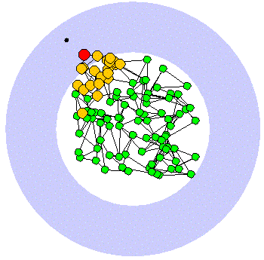
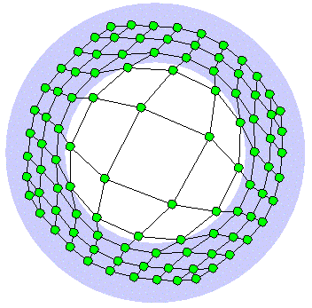
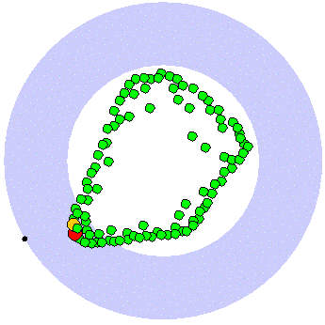
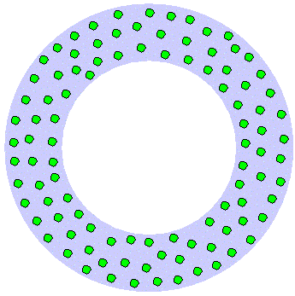
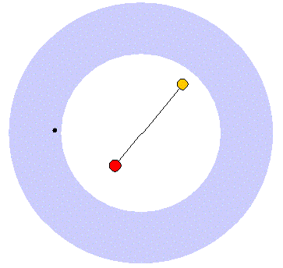
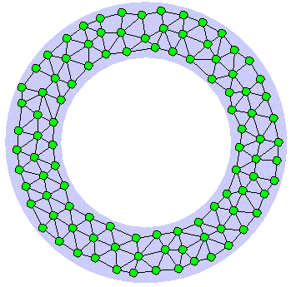
Unsupervised neural methods
Kohonen’s self organizing maps (SOM) fixed topographic structure (grid of neurons)
Neural Gas (NG) codebook vectors (neurons) adapted without any fixed topologic arrangement
Growing Neural Gas (GNG) number of neurons changing periodically
…
Notes:
Plusieurs méthodes numériques neuronales ont été proposées dans la littérature pour l’analyse de donnée à savoir la carte de Kohonen qui propose une structure topographique fixe de neurones, la méthode neural gas tels que les vecteurs de référence (neurones) sont adaptés sans aucune arrangement topologique fixe. La méthode growing neural gas est différente que les autres par le fait que le nombre de neurones change périodiquement.

Slide 32
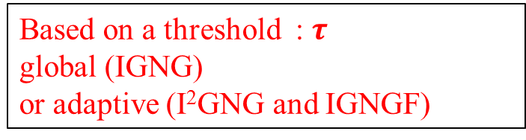
The IGNGF clustering method
New “reactive” IGNGs” family neural clustering methods
σ
Based on a threshold : $τ$
global (IGNG)
or adaptive (I²GNG and IGNGF)

Slide 33

Quality evaluation using full-feature maximization (Principle)
A good clustering model should be able to maximize sum of positive contrast in clusters (≈ generic intra-clusters inertia):
$${PC}_{k}= \frac{1}{k}\sum_{k=1}^{n}{\frac{1}{n_{k}}\sum_{f∈S_{k}}{G_{c}\left(f\right)}}$$
A more complete approach could combine summation of positive and summation of invert of negative contrast (≈ generic intra-cluster and inter-cluster inertia):
$${EC}_{k}= \frac{1}{k}\sum_{k=1}^{n}{\left(\frac{\frac{\left|S_{k}\right|}{n_{k}}\sum_{f∈S_{k}}{G_{c}\left(f\right)}+ \frac{\left|\overline{S_{k}}\right|}{n_{k}}\sum_{h∈\overline{S_{k}}}{\frac{1}{G_{c}\left(h\right)}}}{\left|S_{k}\right|+ \left|\overline{S_{k}}\right|}\right)}$$

Slide 34
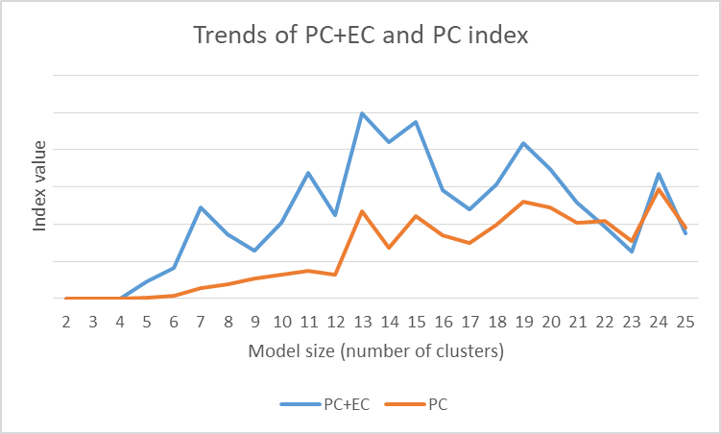
Quality evaluation on experimental data
The optimal model is the 13 clusters model.

Slide 35
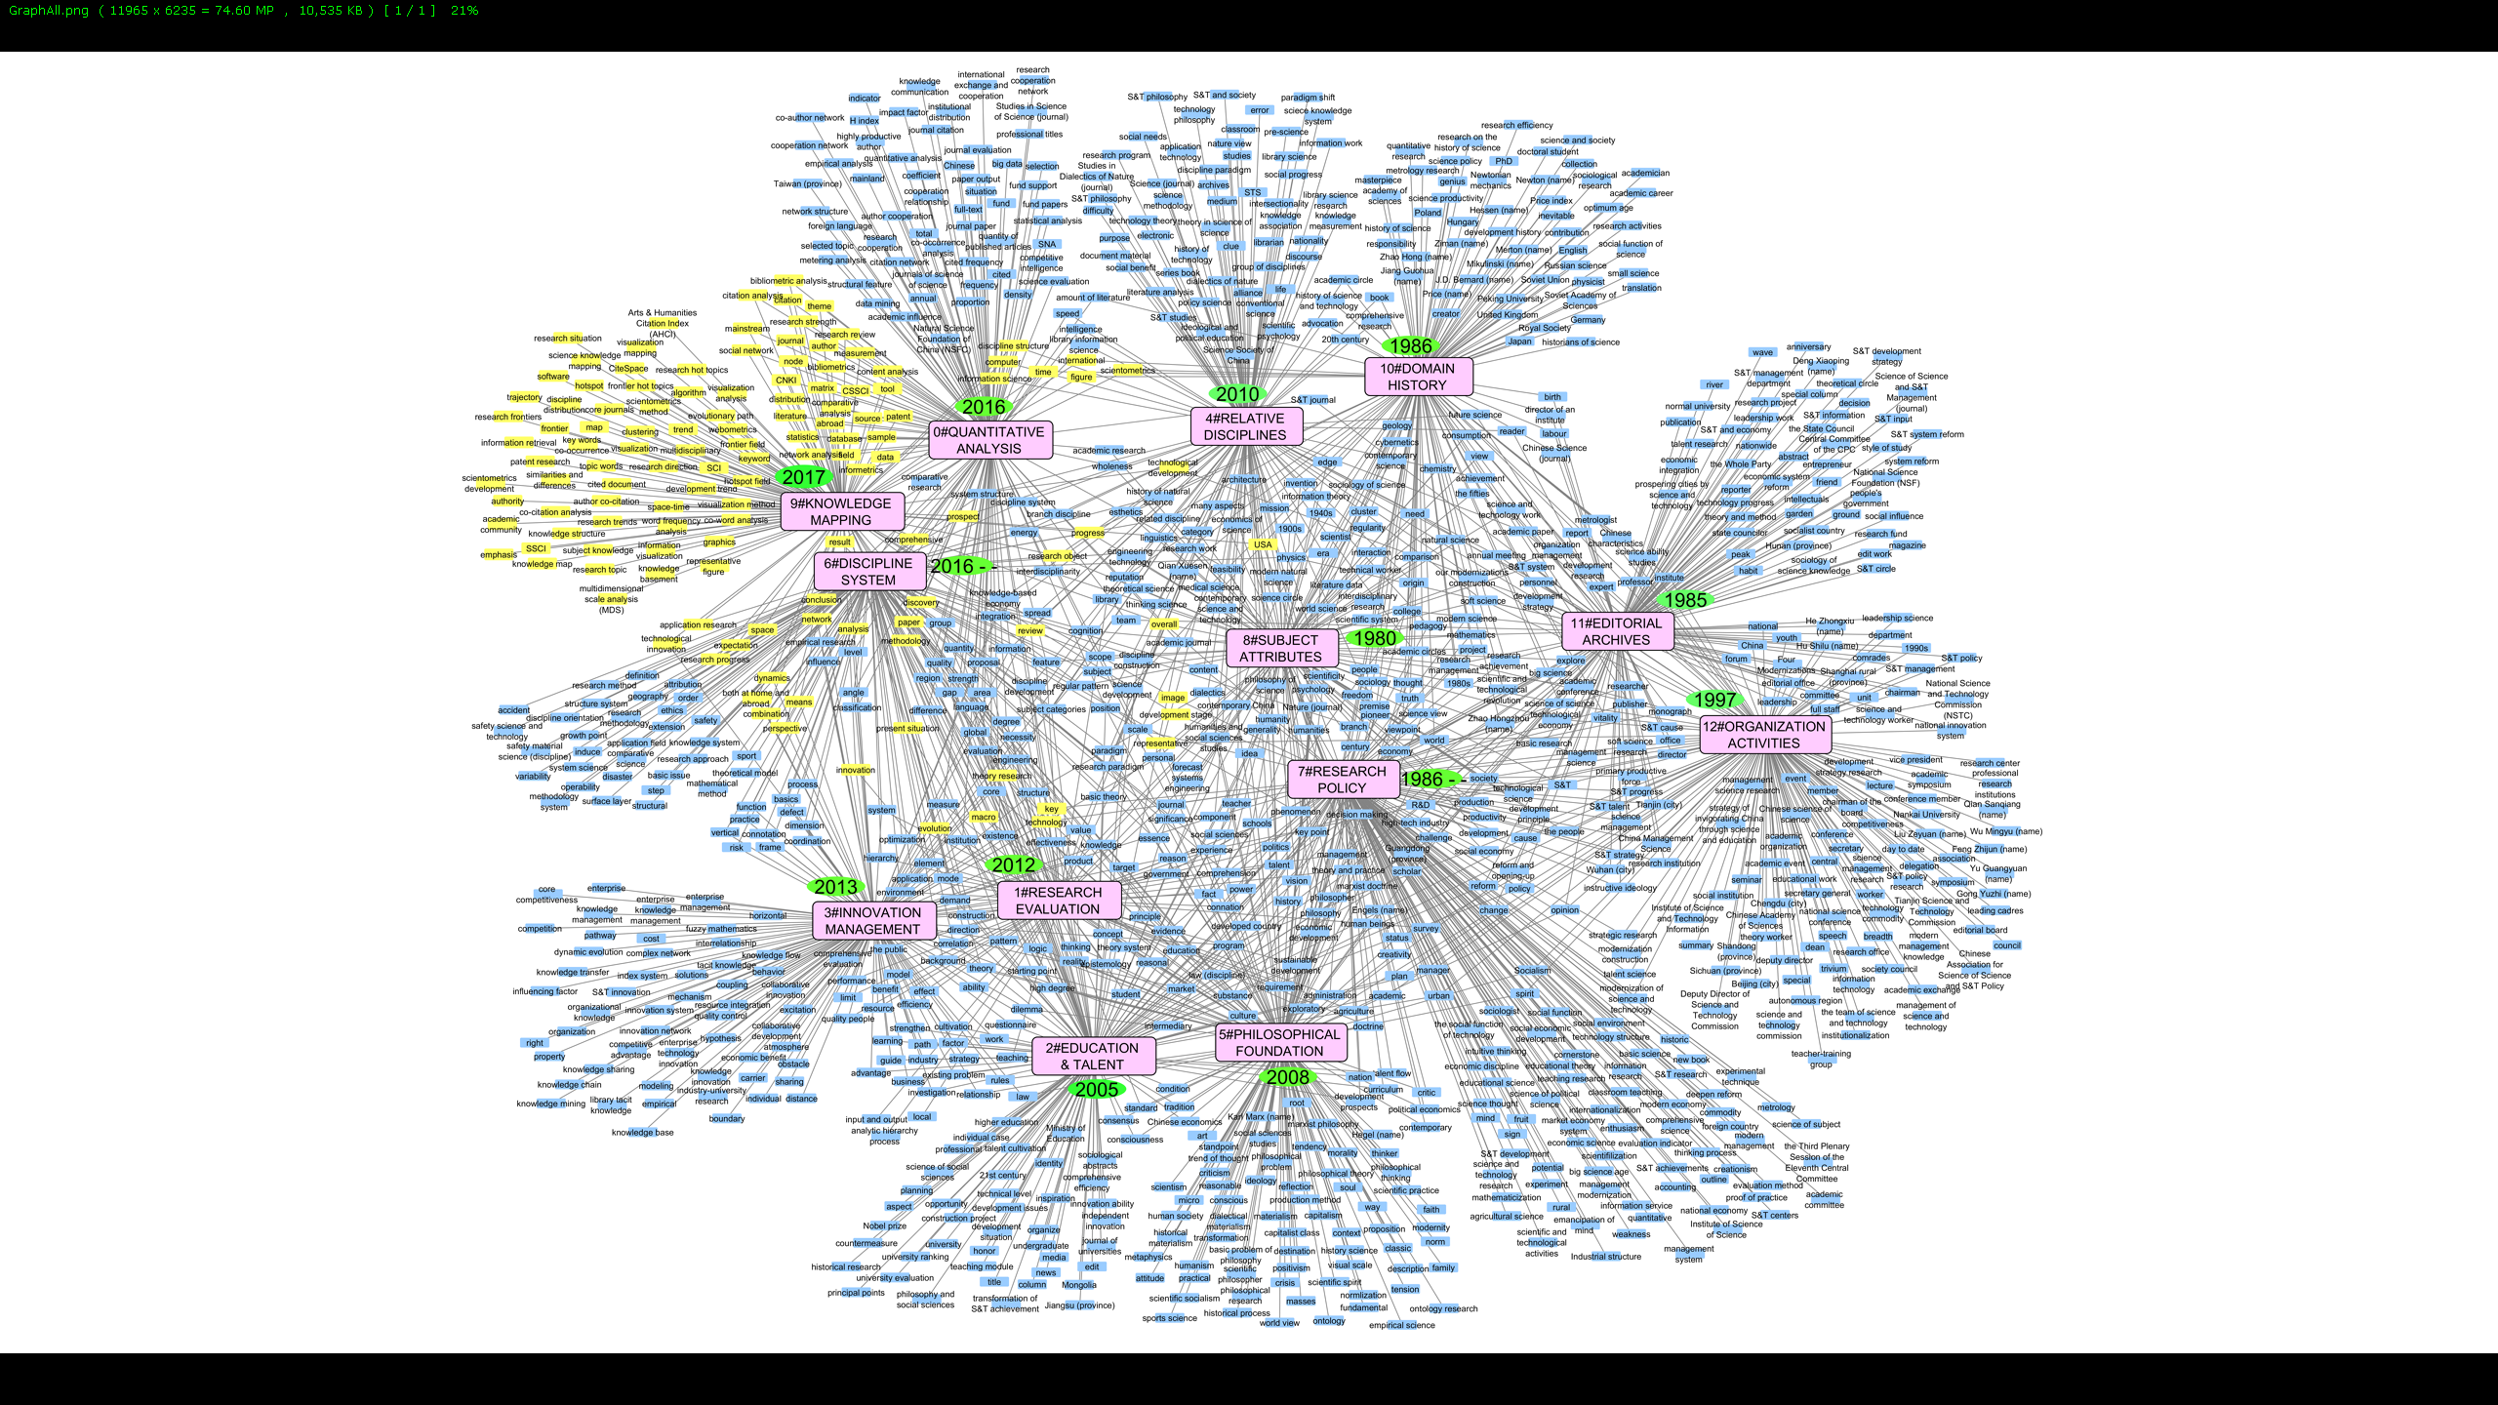
On going research on contrast graph
…
A. Science knowledge system - cognition perspective
C. Scientific activity guaranty - institutional perspective
Core
B. Science practice system - application perspective

Slide 36
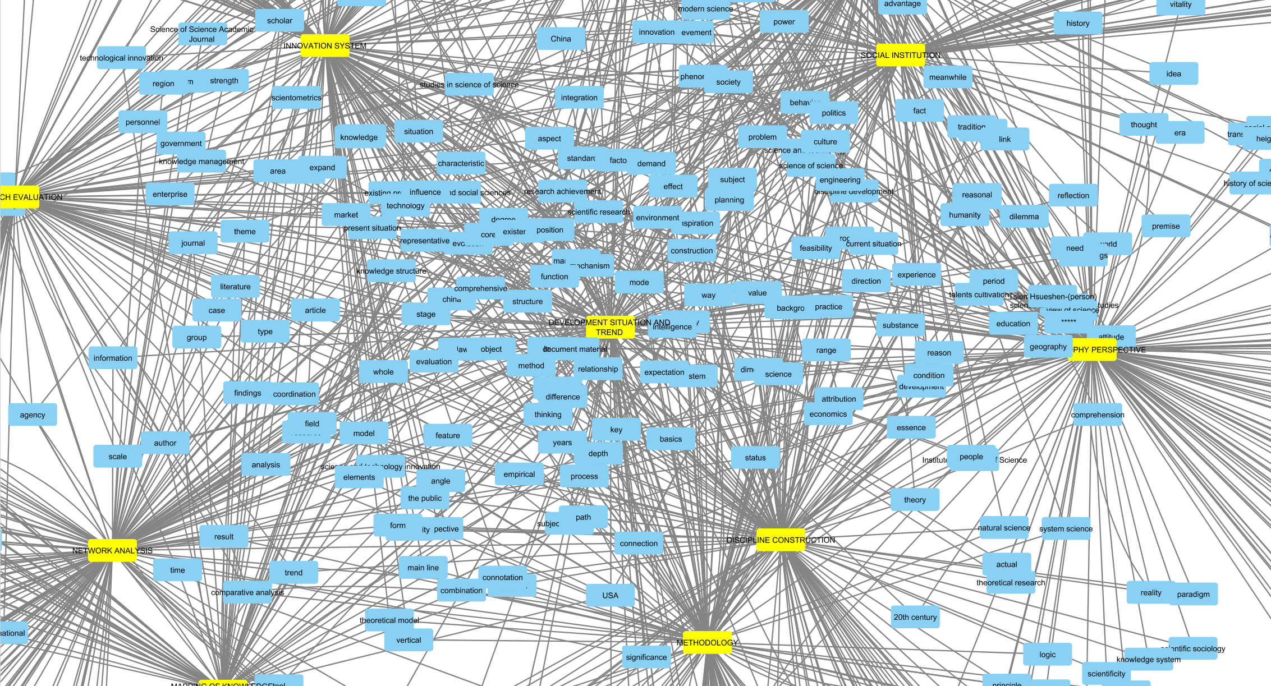
On going work on F-Max metric
Map of Science of Science history in China (cont.)
Local view (zoom)

Slide 37
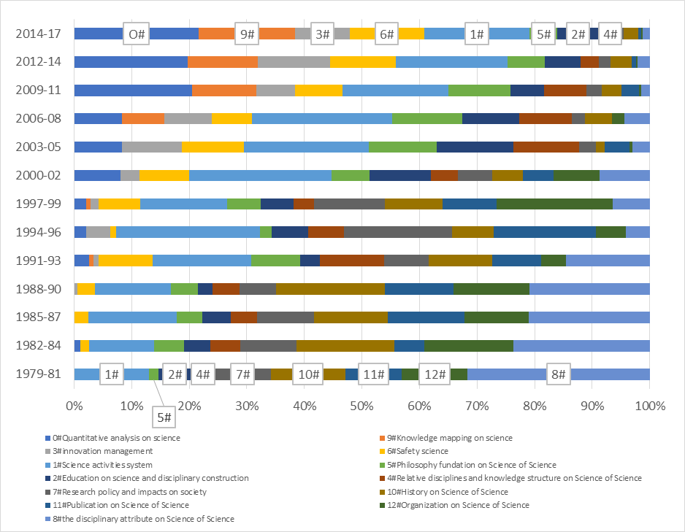
On going research on contrast graph
…

Slide 38
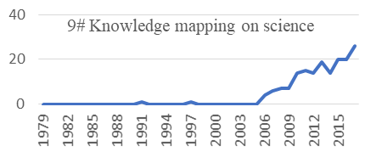
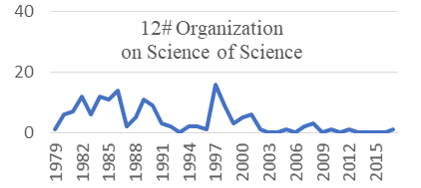
On going research on contrast graph
… : research topics and their evolution
5.376770 theme，
5.030978 research hot topics，
4.827424 literature，
4.734794 software，
4.697236 frontier，
4.595268 development trend，
4.401170 research topic，
4.342141 hotspot，
4.159228 both at home and abroad，
3.989917 science knowledge mapping，
3.873852 international，
3.801943 expectation，
3.648744 visualization analysis，
…….
3.130080 trajectory，
2.930680 clustering，
2.872097 research trends，
2.855751 topic words，
2.779299 distribution，
……,
Results have been validated by Chinese experts of the domain arguing that the method provide them with very fine grained description of domain history, evolution and domain topics interaction

Slide 39

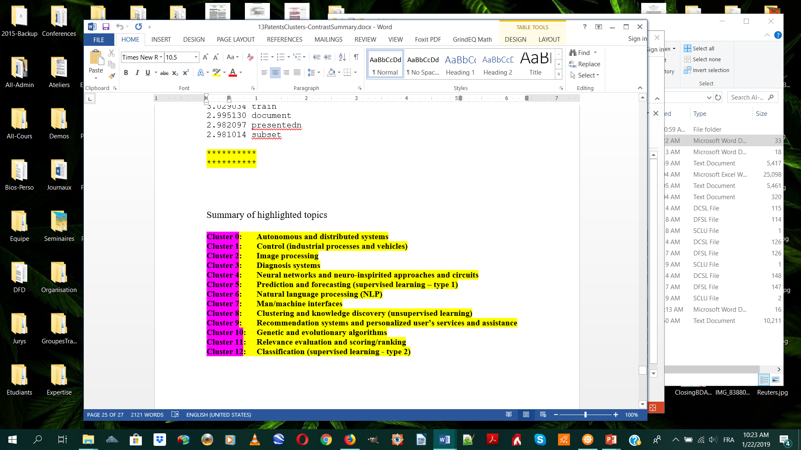
Comparison with LDA
Topic extraction capabilities
In the 10 topic it found, LDA method identify 2 only main topics (including one with high noise) among main topics of AI domain. Other found topics were either minor topics or a mix of general terms and noise.
Our proposed method put all the 12 main topics of AI into evidence with very low noise in their descriptions.

